Slide 1
Accessing ingredient data from IndiCater’s Recipe Manager API
3rd parties have two options regarding ingredients when accessing dish data for Natasha’s Law from our API; unformatted or formatted ingredients.
Formatted ingredients – ingredients will be per dish, will be in descending weight order and will include the item name as it should appear on the label
Unformatted ingredients –ingredients will be per item in a dish and will not be formatted per dish. Items will be as per the supplier catalogue name

Slide 2
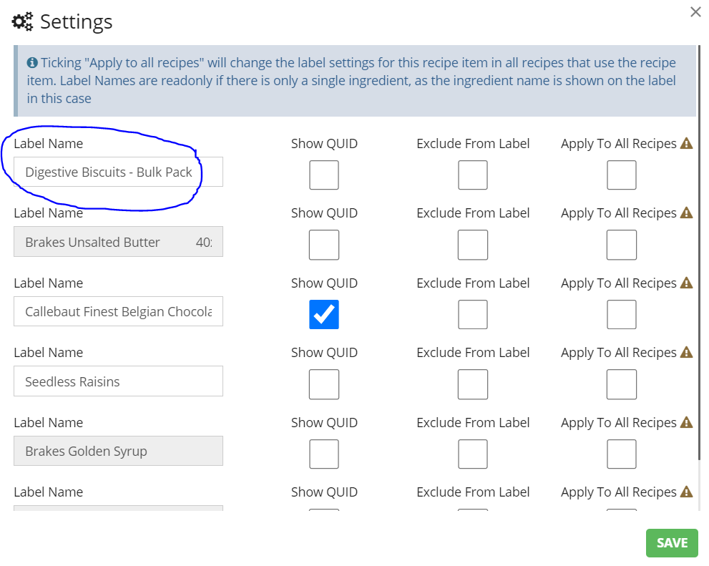
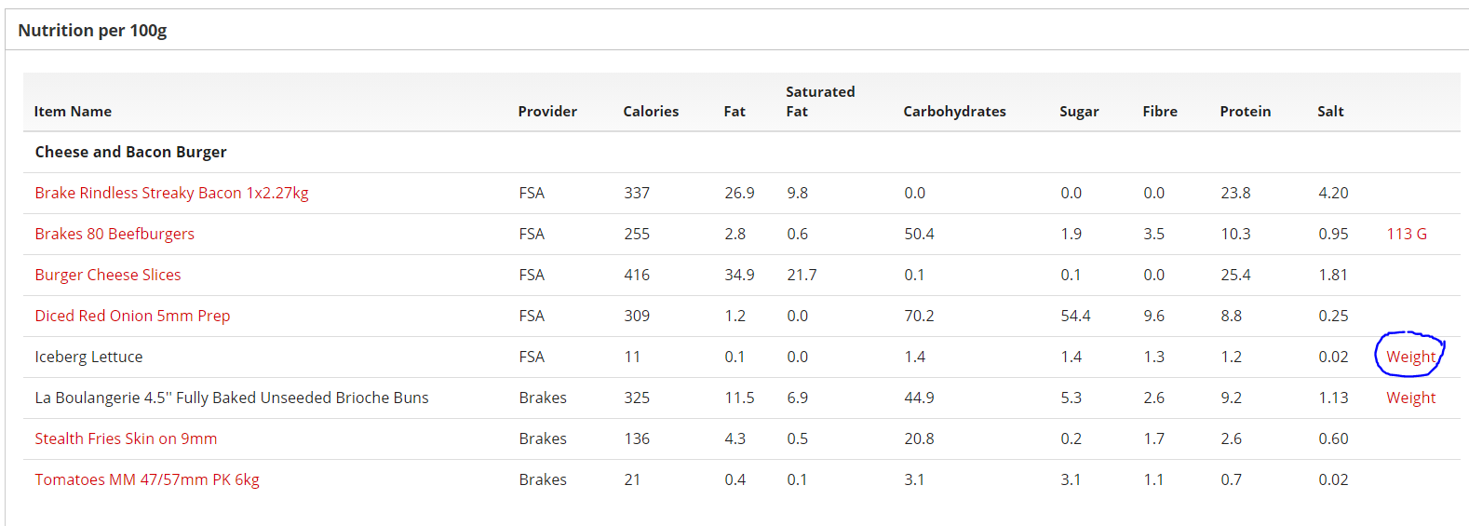
Process flow of data needed for Natasha’s Law – formatted ingredients
Catalogue and ingredients uploaded
Recipes created
Weights added to recipes
Ingredient names changed where required
Dish details including ingredients accessed via API
The weight is needed to be able to sort ingredients by descending weight order. Any weight that can’t be calculated need to be entered, eg 1 egg = 6g
Amend the label name of an item, eg to remove a brand or pack size. This is only required for items that have their own list of ingredients as the item name will be shown

Slide 3
Process flow of data needed for Natasha’s Law – unformatted ingredients
Catalogue and ingredients uploaded
Recipes created
Dish details including ingredients accessed via API
Check all dishes contain ingredients
This will be available as a report in time but can be done by IndiCater in request at the moment
Supplier task
Client task
3rd party task

